Slide 1
Revision Physics
Ms: Mariam
Preparing students :
Mostafa Emad
Zeyad Maged
Mostafa Hatem

Slide 2
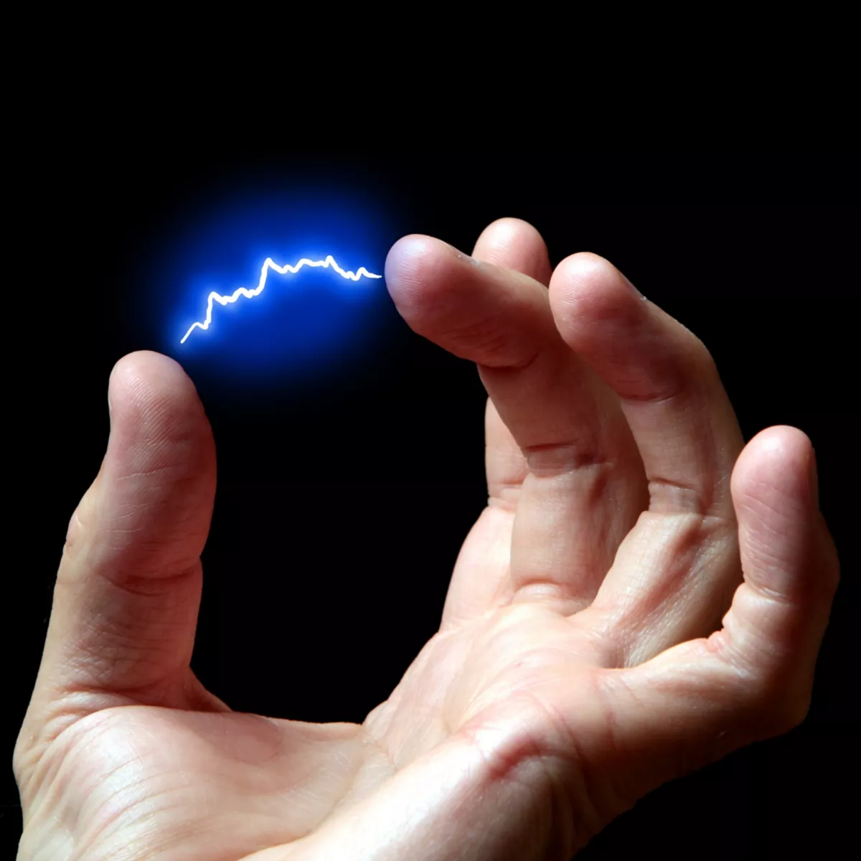
Lesson 1 Meaning of static electricity
ELECTRICITY:
Electricity is the flow of electrical charges or power. The charges could be
in the form of electrons or ions. Electricity or electrical energy is a secondary energy source which means that we get it from the conversion of other sources of energy, like by burning coal, natural gas, oil or from nuclear power and other natural sources, which are called primary energy

Slide 3
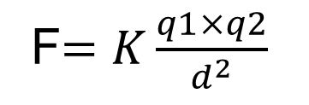

Lesson 2 Coulomb’s law
When charges are at rest in, they exert electrostatic forces on each other. These forces are of great importance in chemistry and biology and have many technological applications. Electrostatic forces are governed by a simple relationship known as Coulomb’s law and are most conveniently described by using the concept of electric field.
F$=K\frac{q1×q2}{d^{2}}$
K$=9{×10}^{9}$ N. $m^{2}$/ $C^{2}$

Slide 4

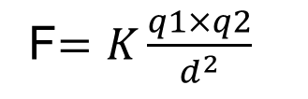

The Frist Example
What must be the distance between point charge q1 = 26 μC and point charge
q2 = −47 μC for the electrostatic force between them to have a magnitude of 5.7 N?
F$=K\frac{q1×q2}{d^{2}}$
5.7$=9{×10}^{9}\frac{26 ×{10}^{−6}× 47 ×{10}^{−6}}{d^{2}}$
$d^{2}$=1.93 $m^{2}$
d=1.39m

Slide 5
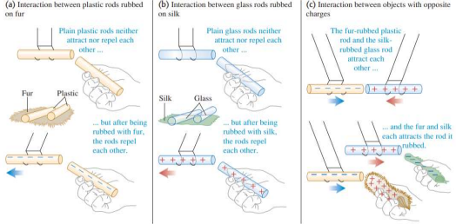
Lesson 3 The repulsive and attractive forces
When you scuff your shoes across a nylon carpet, you become electrically charged, and you can charge a comb by passing it through dry hair. Plastic rods and fur (real or fake) are particularly good for demonstrating electrostatics, the interactions between electric charges that are at rest (or nearly so). Figure (a) after we charge both plastic rods by rubbing them with the piece of fur, we find that the rods repel each other. Figure (b) when we rub glass rods with silk, the glass rods also become charged and repel each other . Figure (c) a charged plastic rod attracts a charged glass rod; furthermore, the plastic rod and the fur attract each other, and the glass rod and the silk attract each other. These experiments and many others like them have shown that there are exactly two kinds of electric charge: the kind on the plastic rod rubbed with fur and the kind on the glass rod rubbed with silk

Slide 6

Lesson 4 The electric field
Electric fields arise from electric charges and changing magnetic fields. An electric charge, or a collection of charges, will have an associated electric field. Any charged object placed in this field will experience an electrostatic force as the field interacts with the charge of the object. Field lines represent the force a positively charged particle would experience if it were in the field at that point.
E$=\frac{F}{Q}$ = $\frac{K×q}{d^{2}}$

Slide 7


The Frist Example
A force of 2 N is acting on the charge 4 μ C at any point. Calculate the electric field intensity at that point.
E$=\frac{F}{Q}$
E$=\frac{2}{4 ×{10}^{−6}}$=5 $× {10}^{5} N/C$

Slide 8
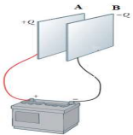
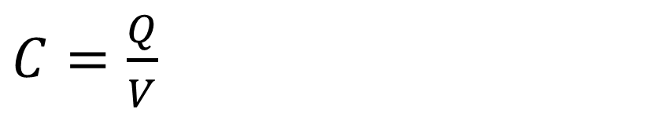
Lesson 5 The capacitor
Capacitors are commonly used in a variety of electric circuits. For instance, they are used to tune the frequency of radio receivers, as filters in power supplies, to eliminate sparking in automobile ignition systems, and as energy-storing devices in electronic flash units.
Definition
(Two parallel metal plates separated by an insulator)
$C=\frac{Q}{V}$

Slide 9
Lesson 1
Some concepts of dynamic electricity
Materials are classified into 3 types according to their electrical conductivity :
1-Connectors
* They are materials that allow electricity to flow through them easily
* Metals conduct electricity, such as copper, silver, and gold.
2- Insulators
* They cannot allow electricity to easily flow through it.
*Examples: wood, paper, plastic, ceramics.
3 - Semiconductors
*They are materials with a conductivity somewhere between conductors and insulators.
* Examples include silicon and germanium

Slide 10

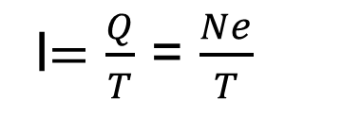


Electric current
(It is the amount of charge flowing through a conductor)
(the flow of electric charges through any cross section of the conductor).
e=1.5$× {10}^{−19}$
1) the electric current intensity (I)
(It is the amount of electric charges flowing per second through a conductor)
(the rate of flow of electric charges through any cross section of the conductor)
I$=\frac{Q}{T}$ = $\frac{Ne}{T}$
2) Potential Difference between two points (V)
(It is the work done in joules to transfer a unit charge (1C) between the two points)
V$=\frac{W}{Q}$
3) The electric resistance (R)
(It's the opposition of the conductor to the flow of electric current due to the friction)
(it's the ratio between the potential difference (voltage) across the conductor and current intensity passing through it at certain temperature)
R$=\frac{V}{I}$

Slide 11
Lesson 2
Ohm’s law
Ohm's Law
The current intensity flowing through a conductor is directly proportional to the potential difference across it at constant temperature
law
V=IR

Slide 12
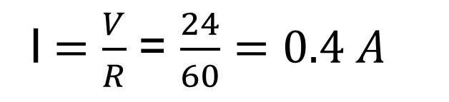
The Frist Example
An electrical element which has a resistance of 60 Ω is connected across a 24 V power supply. Calculate the current drawn from the power supply
I$=\frac{V}{R}$ = $\frac{24}{60}=0.4 A$

Slide 13
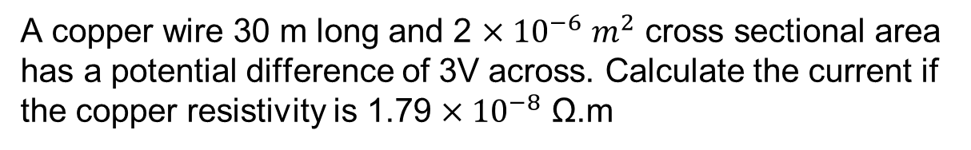
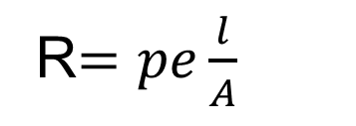
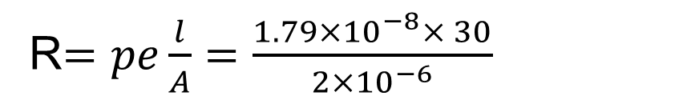
Lesson 3
The ohmic resistance
R$=pe\frac{l}{A}$
A copper wire 30 m long and 2 ${×10}^{−6}$ $m^{2}$ cross sectional area has a potential difference of 3V across. Calculate the current if the copper resistivity is 1.79 ${×10}^{−8}$ Ω.m
R$=pe\frac{l}{A}=\frac{1.79{×10}^{−8}× 30}{2{×10}^{−6}}$
R = 0.2564 ohm
V = I R 3 = I (0.2564) I = 11.17 Amp.

Slide 14
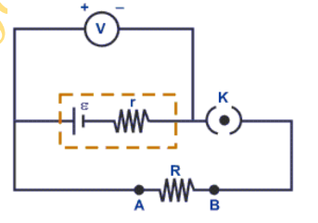
Lesson 4
Ohm’s law for closed circuit
In an electric circuit there must be a device somewhere in the loop that acts like the water pump in a water fountain. The influence that makes current flow in the circuit is called electromotive force (abbreviated emf). This is a poor term because emf is not a force but an energy-per-unit-charge quantity
VB = I Req + I r = I (Req + r)
I = VB / (Req + r)

Slide 15
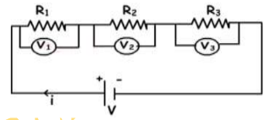
Lesson 5
Connection of resistors
There are two ways to connect multiple resistors to a voltage source one is called series and the other is called parallel
Resistors are connected in series to obtain a higher resistance out of a group of large resistances
Resistors connected in parallel to obtain a small resistance out of a group of large resistances
1)The current through all the resistors is the same (I = I1 = I2 = I3)
2)The potential difference is split (Vt = V1 + V2 +V3)
3) The equivalent resistance is greater than the greatest resistance Req = R1 + R2 + R3

Slide 16
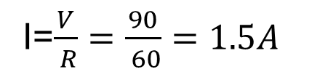
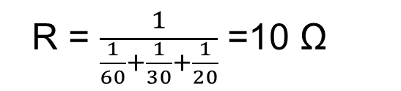
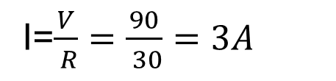
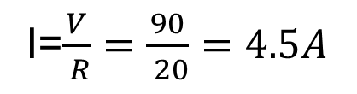
Three resistors of 60 Ω, 30 Ω, and 20 Ω are connected in parallel across a 90V difference in potential. Calculate
the equivalent resistance of the circuit
the current in the circuit
the current through each branch of the circuit.
R = $\frac{1}{\frac{1}{60}+\frac{1}{30}+\frac{1}{20}}$ =10 Ω
V = I R 90 = I (10) I = 9A
I=$\frac{V}{ R}=$ $\frac{90}{ 60}=1.5A$
I=$\frac{V}{ R}=$ $\frac{90}{ 30}=3A$
I=$\frac{V}{ R}=$ $\frac{90}{ 20}=4.5A$

Slide 17
Thanks For listening

